Slide 1
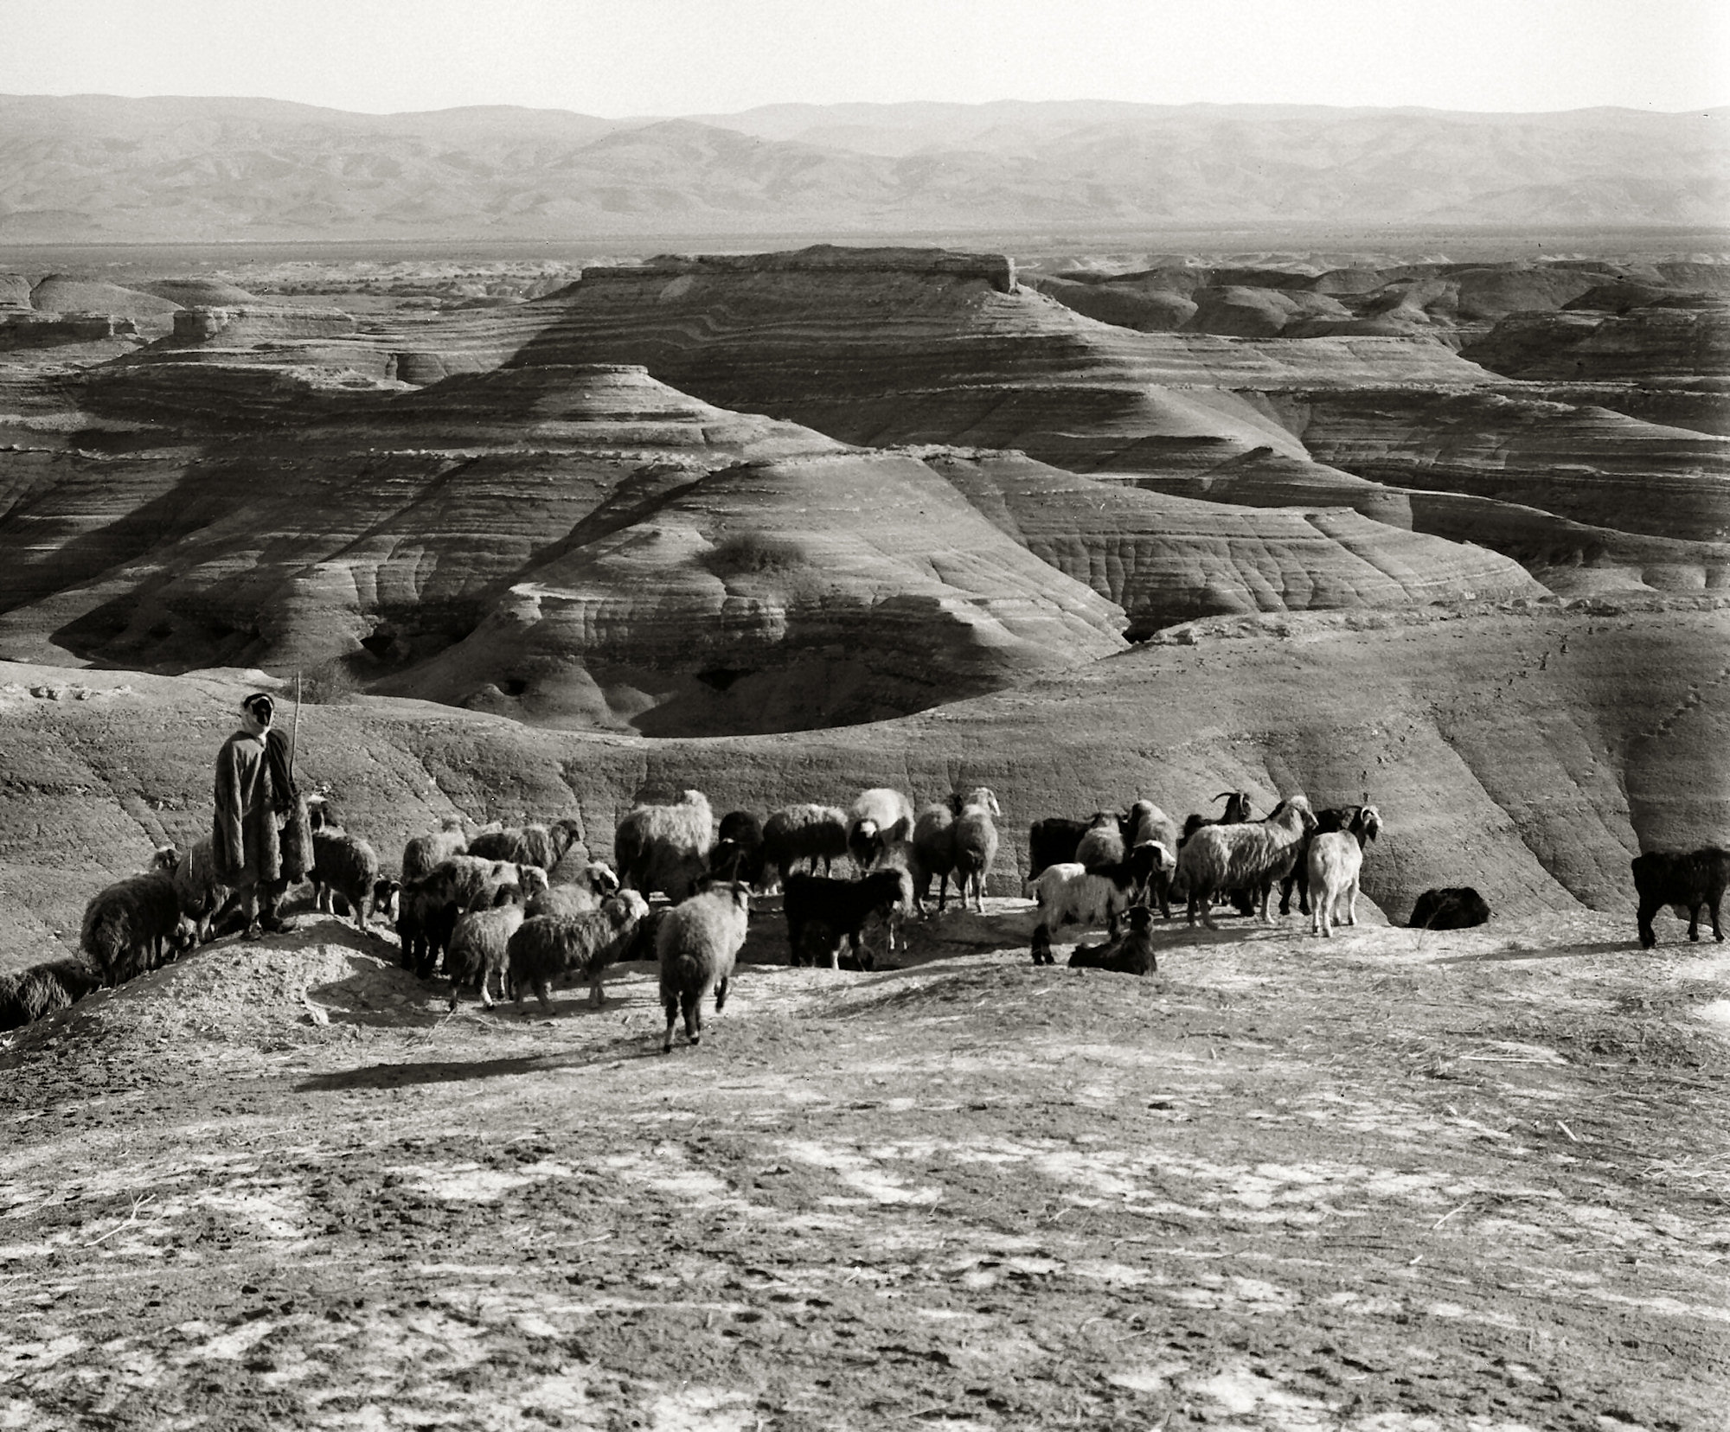
John 10.1-21
All photographs from the Eric Matson Collection;
© 2009 Todd Bolen / LifeintheHolyLand.com

Slide 2
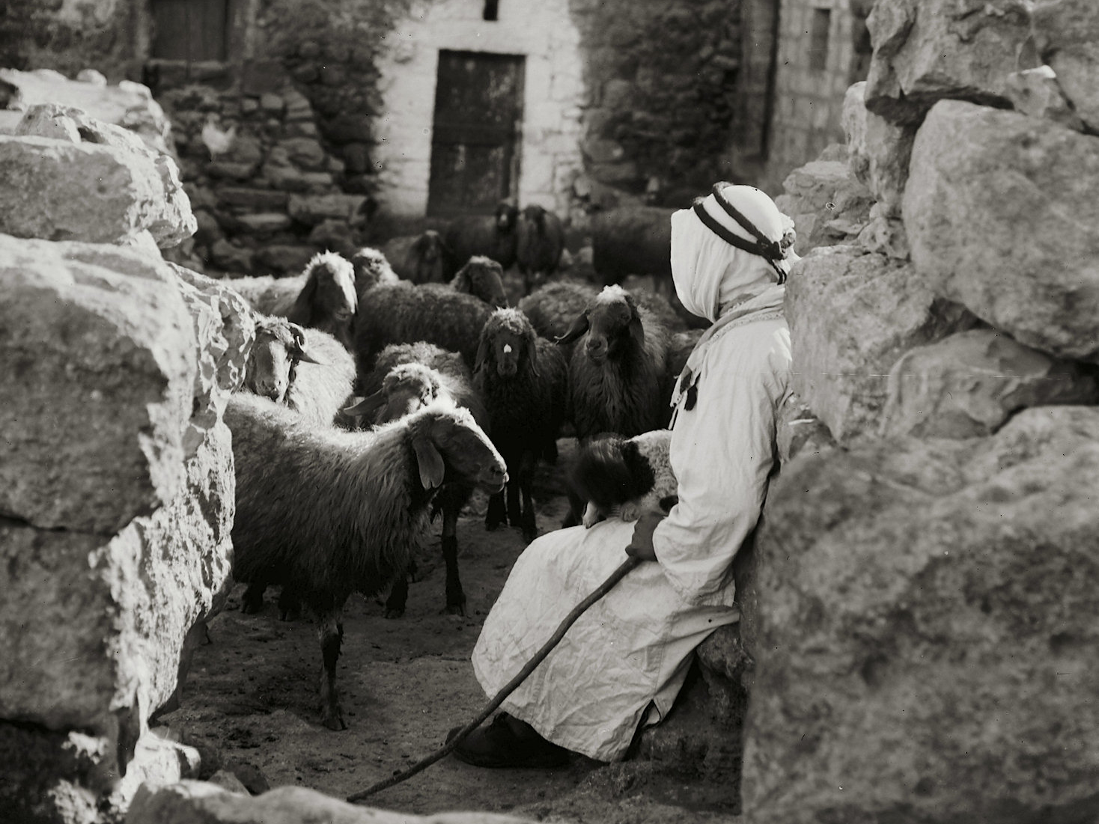
John 10.1 NET: “I tell you the solemn truth, the one who does not enter the sheepfold by the door, but climbs in some other way, is a thief and a robber.

Slide 3
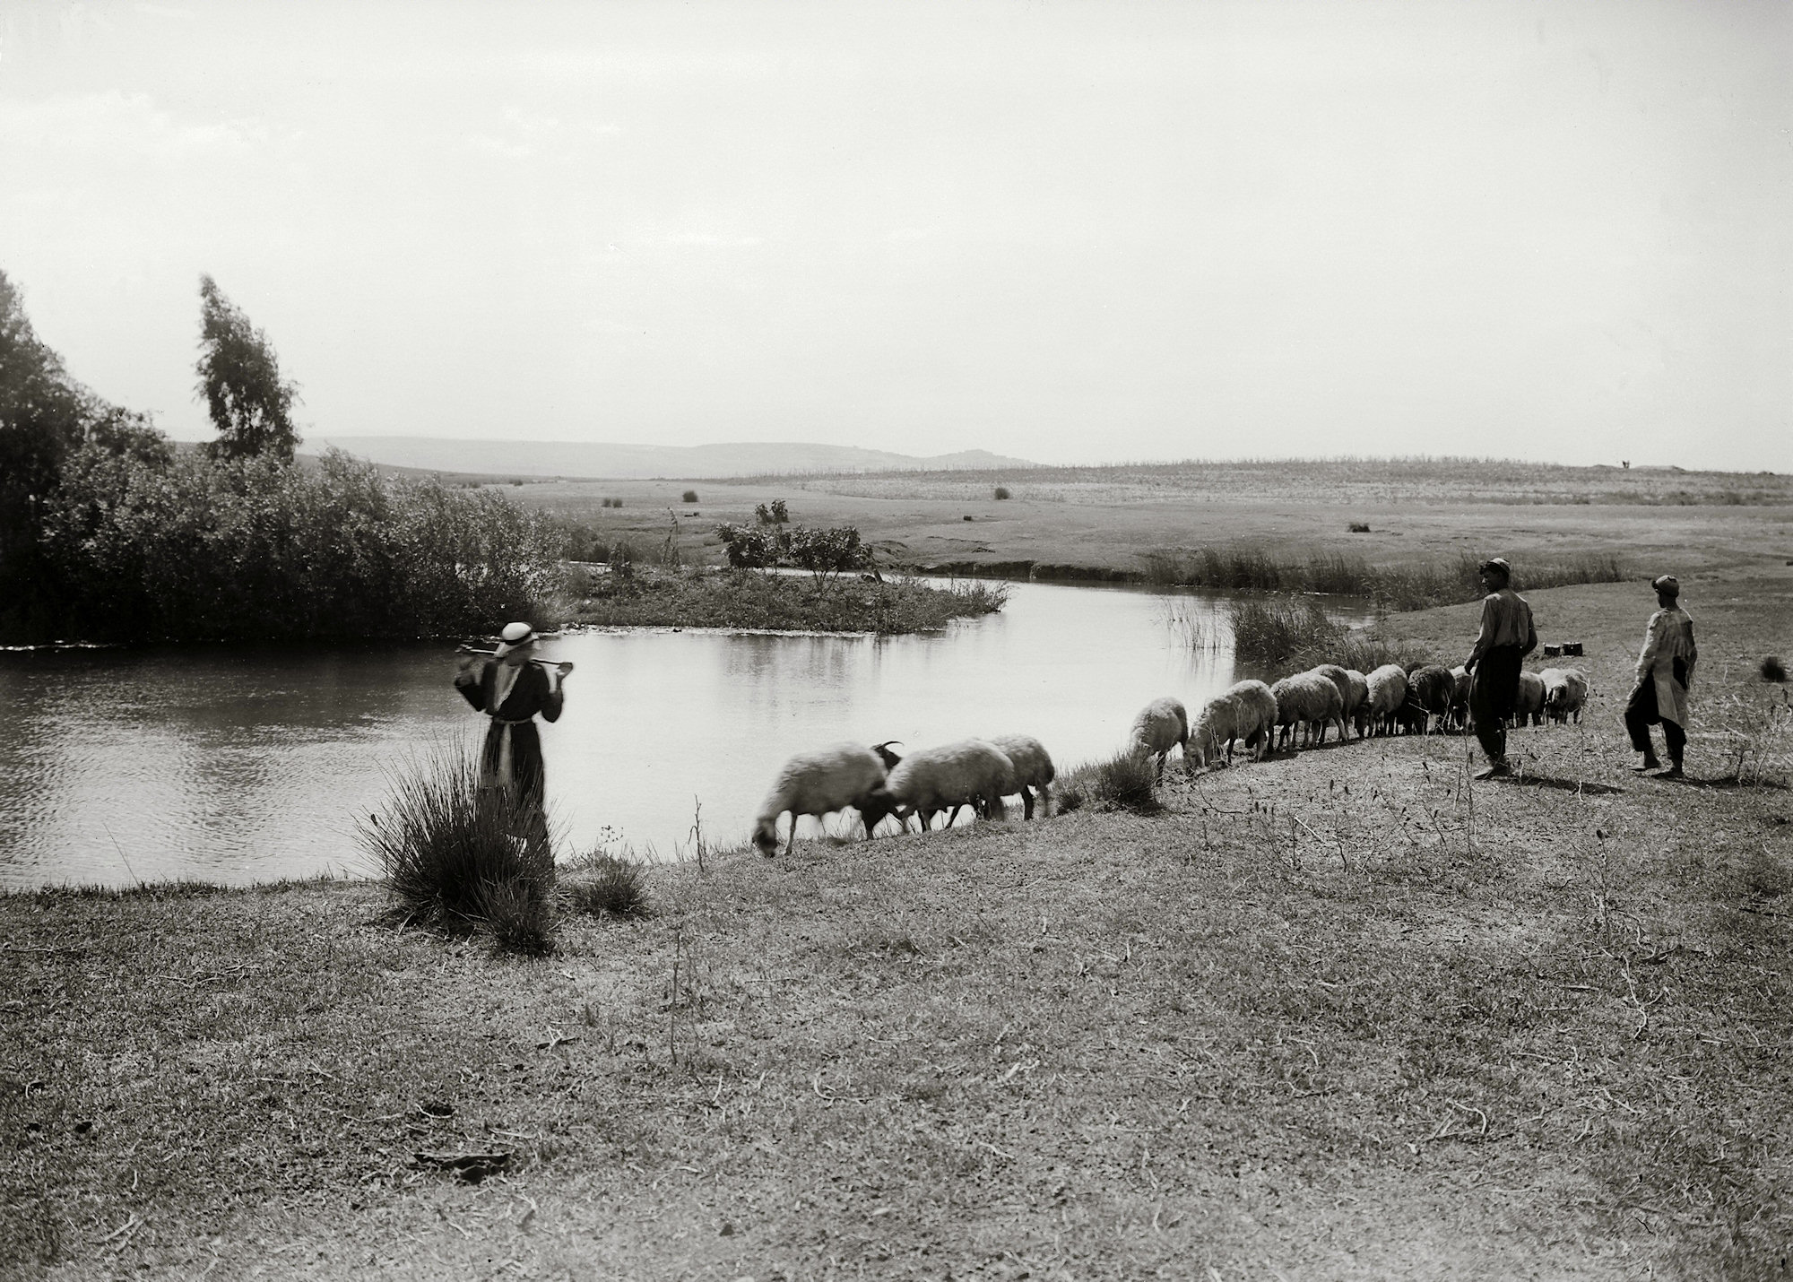
John 10.2-6: “The one who enters by the door is the shepherd of the sheep. The doorkeeper opens the door for him, and the sheep hear his voice. He calls his own sheep by name and leads them out. When he has brought all his own sheep out, he goes ahead of them, and the sheep follow him because they recognize his voice. They will never follow a stranger, but will run away from him, because they do not recognize the stranger's voice.” Jesus told them this parable, but they did not understand what he was saying to them.

Slide 5
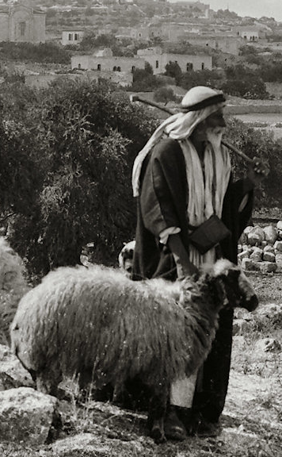
 The political and religious leaders of Israel have harmed the sheep instead of taking care of them. God is angry and will remove their authority.

Slide 6
 The political and religious leaders of Israel have harmed the sheep instead of taking care of them. God is angry and will remove their authority.
 God himself will care for his sheep.

Slide 7
 The political and religious leaders of Israel have harmed the sheep instead of taking care of them. God is angry and will remove their authority.
 God himself will care for his sheep.
 God will appoint “David” to shepherd his sheep. This is a Messianic prophecy.

Slide 8
John 10.7-10: So Jesus said to them again, “I tell you the solemn truth, I am the door for the sheep. All who came before me were thieves and robbers, but the sheep did not listen to them. I am the door. If anyone enters through me, he will be saved, and will come in and go out, and find pasture. The thief comes only to steal and kill and destroy; I have come so that they may have life, and may have it abundantly.”

Slide 9
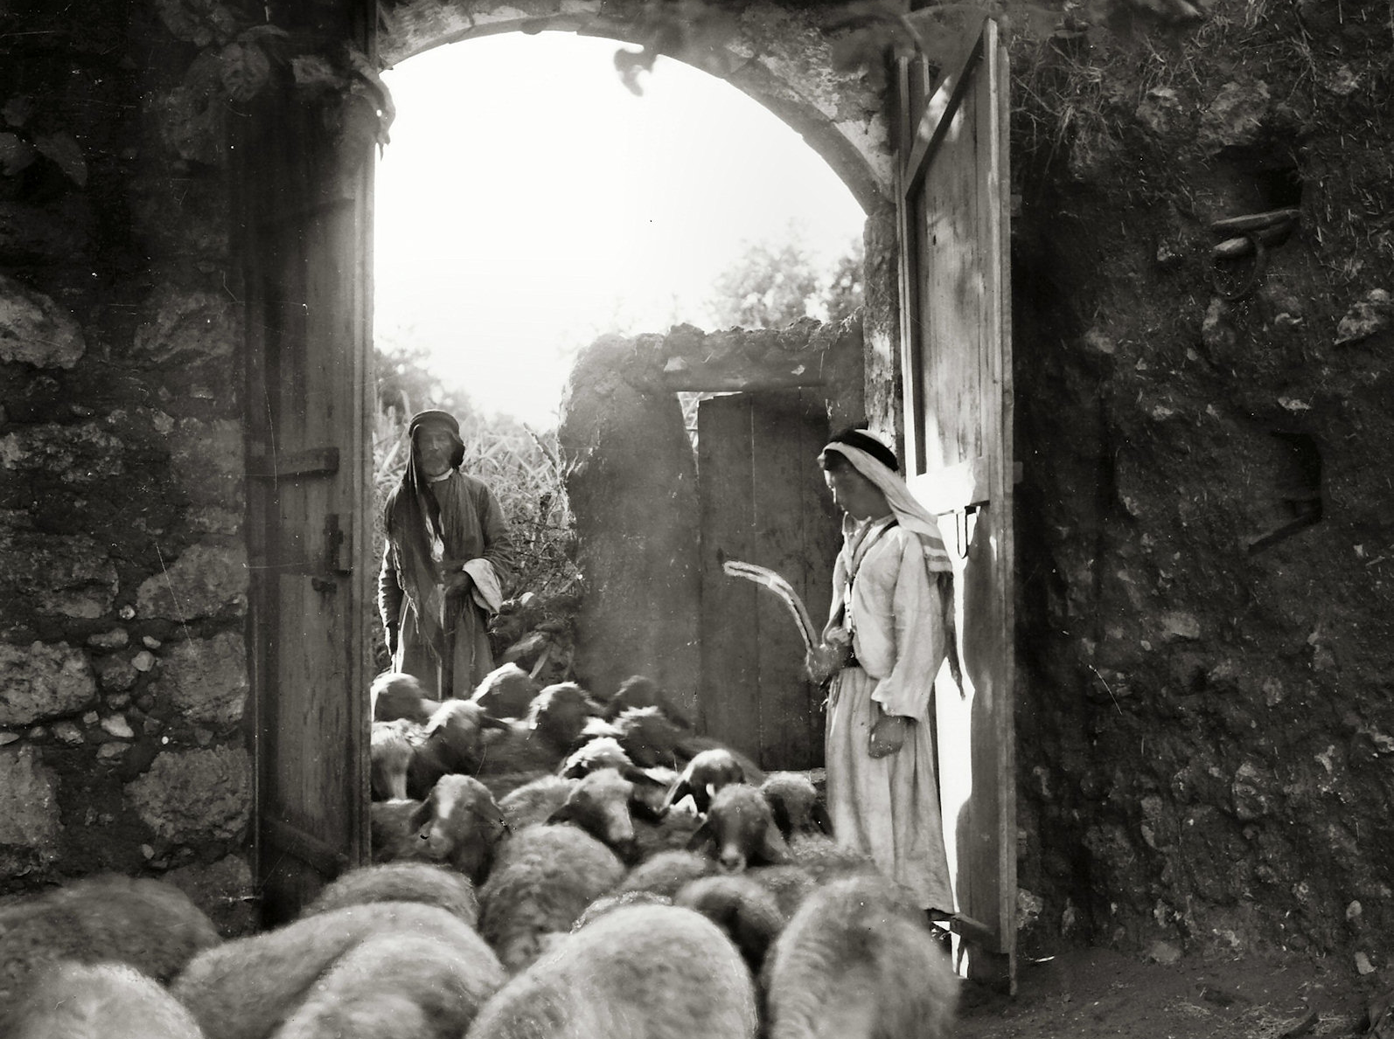

Slide 10
John 10.11-15: “I am the good shepherd. The good shepherd lays down his life for the sheep. The hired hand, who is not a shepherd and does not own sheep, sees the wolf coming and abandons the sheep and runs away. So the wolf attacks the sheep and scatters them. Because he is a hired hand and is not concerned about the sheep, he runs away. I am the good shepherd. I know my own and my own know me– just as the Father knows me and I know the Father– and I lay down my life for the sheep.

Slide 12
John 10.16: “I have other sheep that do not come from this sheepfold. I must bring them too, and they will listen to my voice, so that there will be one flock and one shepherd.”

Slide 13
John 10.17-18: “This is why the Father loves me– because I lay down my life, so that I may take it back again. No one takes it away from me, but I lay it down of my own free will. I have the authority to lay it down, and I have the authority to take it back again. This commandment I received from my Father.”

Slide 14
John 10.19-21: Another sharp division took place among the Jewish people because of these words. Many of them were saying, “He is possessed by a demon and has lost his mind! Why do you listen to him?” Others said, “These are not the words of someone possessed by a demon. A demon cannot cause the blind to see, can it?”

